Slide 1
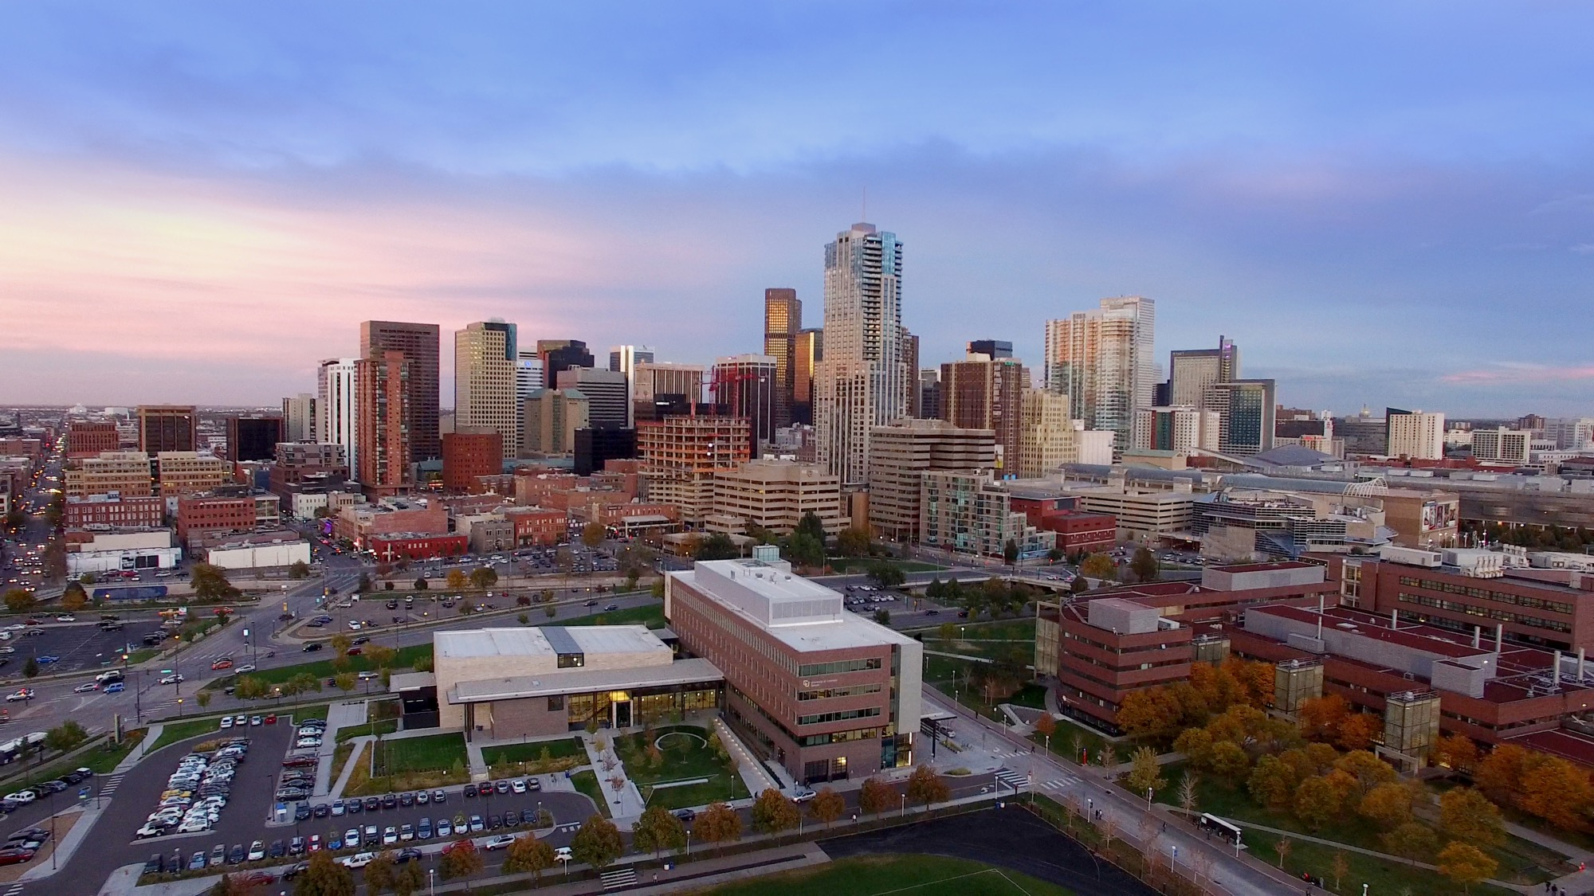

Style text-to-transfer: Shakespearean Formal English to Modern Style Transfer

Slide 2
Team member: Anmol Singhal , 111021672
Bhavishya Vudatha , 111091008
Pooja Kulkarni , 111024438
Sai Krishna Karnam , 110942676
Video Link: NLP Project Presentation and Output Video.mp4

Slide 3
Problem Statement
The project aims to create a system that converts Shakespearean English into modern English sentences. This will help people understand these classic texts more easily while keeping the original meaning and tone. We will use natural language processing (NLP) techniques focusing on style text-to-transfer branch to make this possible

Slide 4
Motivation
Importance of Simplifying Classics:
Classic texts are difficult for modern readers to understand.
Simplified versions can make them accessible while retaining depth.
Existing Challenges:
Limited access to and understanding of complex classics.
Maintaining emotional nuance while simplifying language is difficult.
User Perspective:
Inspired by personal struggles with complex classic texts.
Highlighted the need for tools to simplify and clarify content.
Project Goal:
Translate Shakespeare’s works into Modern English while preserving meaning.
Use NLP to ensure accuracy, clarity, and emotional impact.
Impact:
Makes classic literature relatable for modern readers.
Promotes accessibility and innovation through AI-driven style transfer.

Slide 5
Methodology
Data Collection and Preprocessing : Collected and cleaned data
Data Augmentation : Generate additional examples, improving dataset diversity.
Model Training and Fine-Tuning : Trained and fine-tuned the T5 model
Sentence Conversion : UI for real-time sentence conversion.
Evaluation Metrics: Standard NLP metrics.

Slide 6
Data Preprocessing
Data Preparation Overview: Kaggle datasets, web-scraped data
Data Overview (Before Preprocessing): Total Test Data: 1,002 rows , Total Train Data: 69,236 rows
Removing Duplicates: Test Data: 2 rows , Train Data: 698 rows
Removing Overlap Between Test and Train Data: 25 rows from test data.
Bidirectional Data Removal: Identical pairs like"A - B" and "B - A": 0 rows found.
Text Standardization:
Lowercasing all text.
Unicode normalization.

Slide 7
Data Preprocessing
Fixing Missed Spaces: Example: "unfoldHis" → "unfold His"
Train Data: 5 corrections (3 in Shakespearean, 2 in Modern English).
Test Data: None.
Special Character Handling: Example: é → e
Test Data: {'é', '”', '!', ':', '‘', ';', '.', 'è', ']', '(', '"', '-', '’', '—', "'", ',', 'Ô', '?', ')', '[', '“'}
Train Data: {'é', 'ï', '–', '”', '!', '&', ':', 'ç', '…', '‘', ';', '.', 'æ', 'à', 'è', ']', '(', 'â', '"', 'î', '-', '’', '—', ',', "'", 'Ô', '?', ')', 'ê', '$' }
Whitespace Removal: Extra spaces removed.
Contraction Expansion: Example: "can’t" → "cannot"
Data Overview (After Preprocessing): Train Data: 68,538 rows, Test Data: 975 rows
Handling Missing Data: No missing data

Slide 8
Data Augmentation
Enhancing Training Data for robust Model Performance.
Helps models generalize better and avoid overfitting.
Especially useful for small or imbalanced datasets.
Visual:A Simple diagram “Raw Data —> Augmented Data —> Model”
Back Translation:
Translate Modern English to an intermediate language (e.g., French) and back to English.
Adds paraphrased sentences to the dataset while preserving meaning.
Example:
Original Modern English: “May the gods ensure that this is the high point of your glory”
Back Translated: "Let the gods make sure that this is the culmination of your glory"

Slide 9
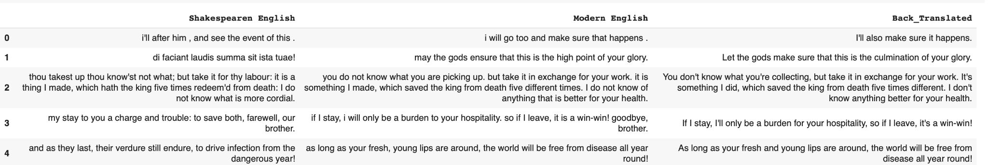
Back Translation Process
Step 1: Randomly sampled 20,000 records from the original dataset for back translation.
Step 2: Convert Modern English to French (Intermediate Language).
Step 3: Translate back to English.
Handling Duplicates:Identified 160 rows where the back-translated text matched the original Modern English and removed.
Goal: Introduce semantic variability while retaining style and meaning.
Tool: Hugging Face MarianMTModel.

Slide 10
Tools Overview
Google Colab: Virtual Environment to train and test the model and access GPUs’
T5-small: We fine-tuned this model to perform the translation task.
Selenium and OpenPyxl to scrape data from web sources
Hugging Face Transformers: MarianMT Model and Marian Tokenizer as part of the back translation process.
Pandas: For Data Preparation and preprocessing.
tqdm: For monitoring model training process.

Slide 11
Model Finetuning
Process:
Split Dataset into testing and evaluation datasets (90-10)
To specify the task to the model: "translate Early English to Modern English: ".
Input and Target sentences - truncated / padded to a constant size and tokenized using the T5 tokenizer.
Trainer API was used to finetune the model and specify the hyperparameters in TrainingArguments.
After the training is completed, Evaluation dataset has been used to extract translated sentences using the fine-tuned model and compute the evaluation metrics.

Slide 12
Model Hyperparameters
Batch Size:
Training: 16 examples per device
Evaluation: 16 examples per device
Learning Rate: 5e-5
Weight Decay: 0.01
Evaluation Strategy: Epoch

Slide 13
Evaluation Metrics
Different metrics are used to assess different aspects of translation quality.
Metrics | Before Augmentation | After Augmentation | Improvements
ChrF Score | 27.01 | 36.36 | +34.6%
BERTScore (F1) | 0.88 | 0.9015 | +2.4%
BLEU Score | 0.0478 | 0.0952 | +99.2%
METEOR Score | 0.2086 | 0.3093 | +48.3%

Slide 14
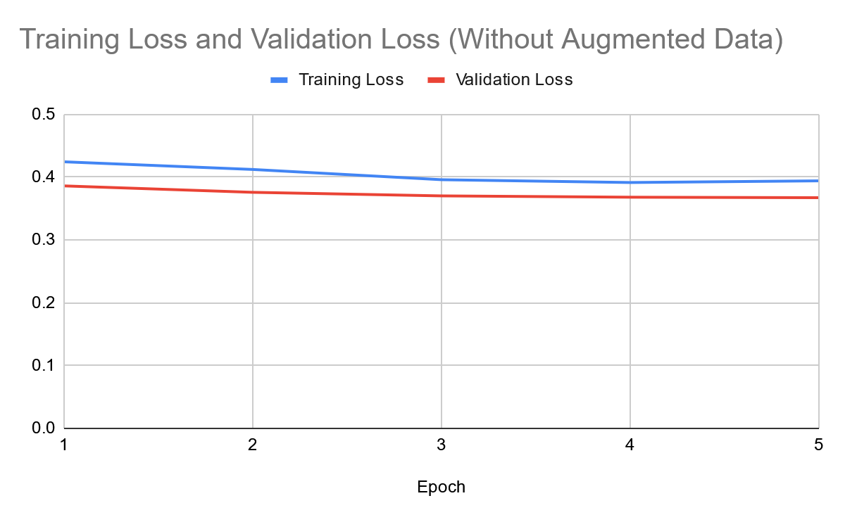
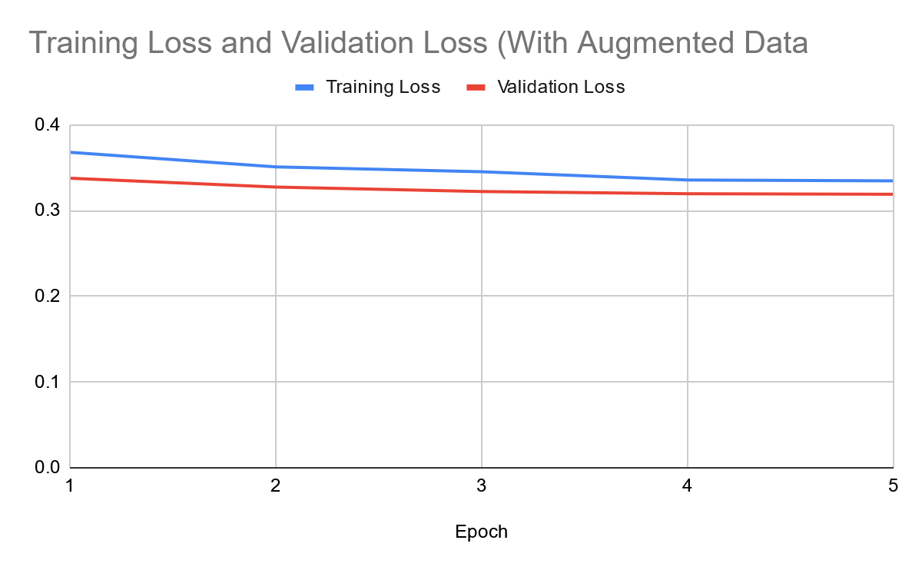
Training and Validation Loss
Loss converges towards the end in both scenarios.
The declining validation loss over epochs indicates effective generalization and minimal overfitting.

Slide 15
Challenges & Solution
Limited Data Availability
Solution: Made use of Data Augmentation to create our own data.
Unable to back translate using GoogleTranslate
Solution: Used MarianMT Transformer from Hugging Face
Finding proper Evaluation scores
Solution: Used BERTScore and ChrF

Slide 16
Future Improvements
Enhancing the Dataset
Expand Dataset Scope:
Include more examples of Shakespearean plays and sonnets.
Add other forms of complex classical texts (e.g., works by Chaucer, Milton, etc.).
Fine-Tuning with Advanced Models:
Experiment with larger pre-trained models like GPT-3 or T5-XL for improved context handling.
Multi-task Learning:
Train a model that can perform translation alongside sentiment analysis or summarization for richer outputs.

Slide 17
Lessons Learned
• Data Preprocessing: Careful handling of spaces, special characters, and contractions improved data consistency,
• Data Quality Matters: High-quality, clean, and diverse data significantly boosted model performance.
• Impact of Data Augmentation: Back translation added diversity to the dataset, improving the model’s understanding of various sentence structures.
• Fine-tuning Pre-trained Models: Leveraging T5-small allowed us to utilize pre-trained knowledge efficiently. It minimized training time while delivering high-quality translation results.

Slide 18
User Interface Features
Translate Page : Input Shakespearean text to real-time modern English translations.
History Page : View the complete history of all translated sentences.
About Page : Learn about the project and team contributions.
Login & Register Pages
User authentication with validation checks:
Username: At least 6 characters, alphanumeric.
Password: At least 8 characters, with a number, uppercase, lowercase, and special character.
No fields can be left blank.

Slide 19
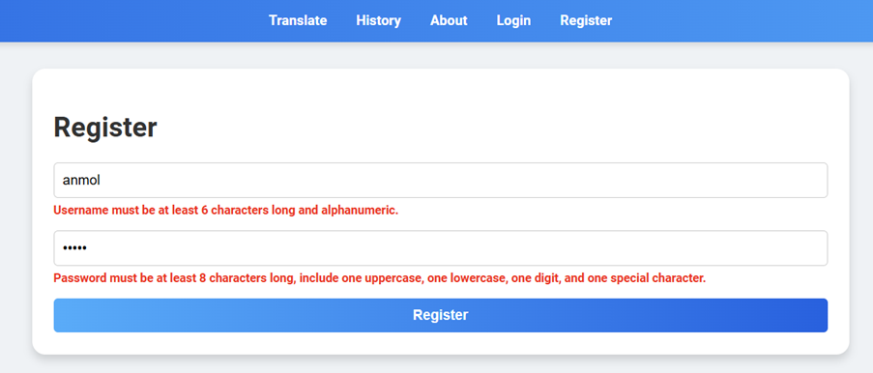
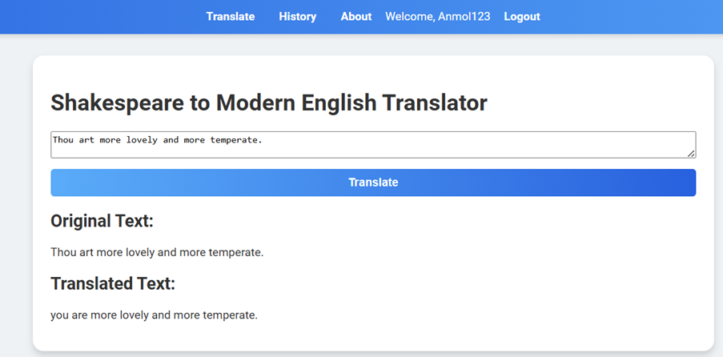
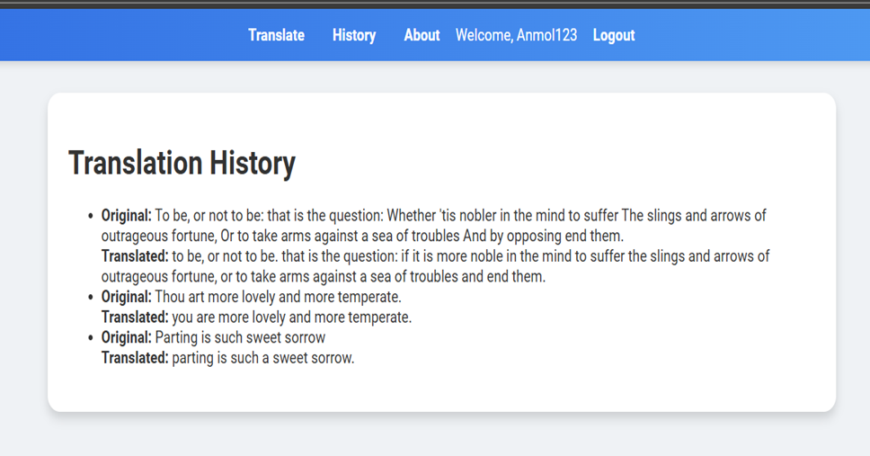
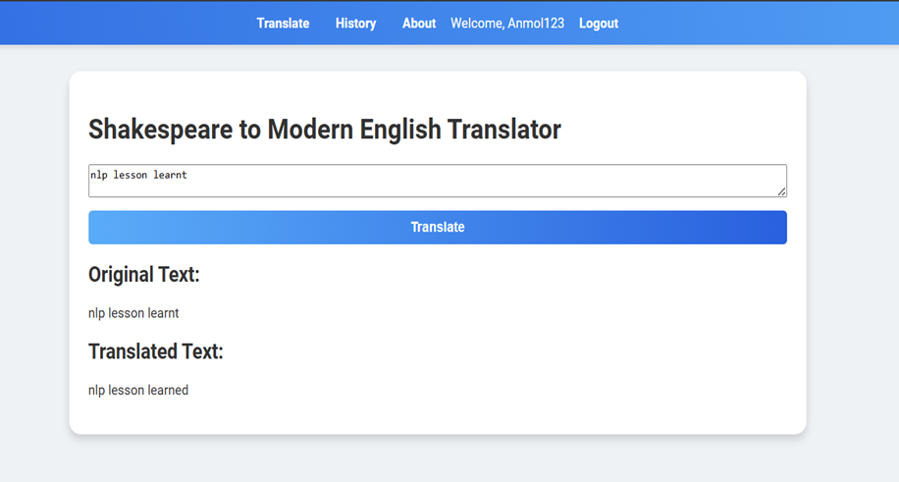
Sample Outputs and checks

Slide 20
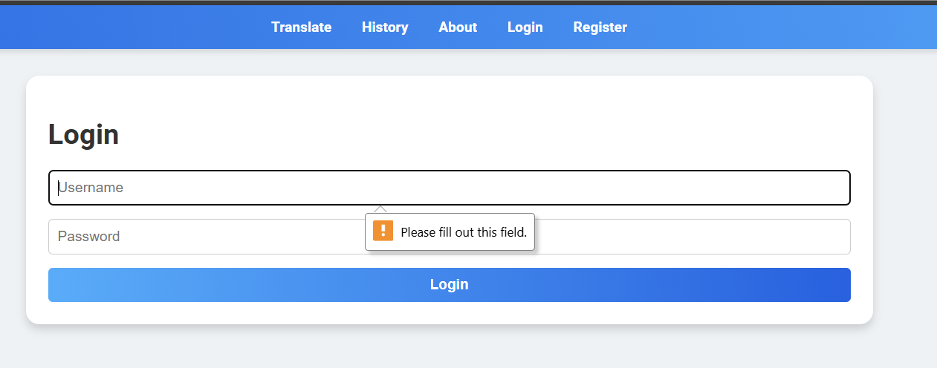
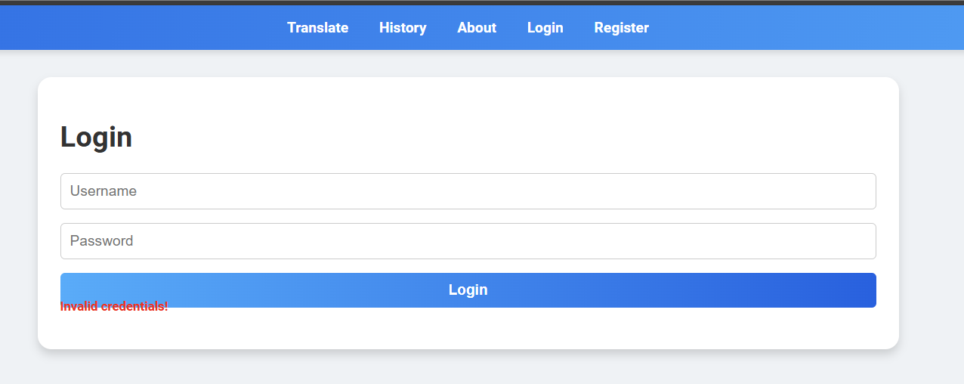
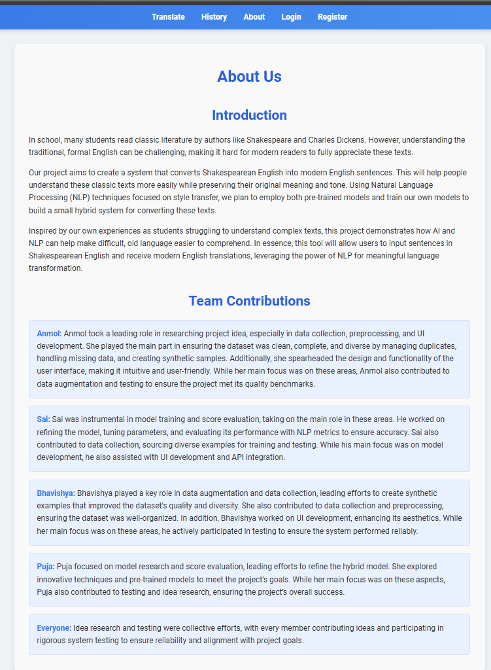
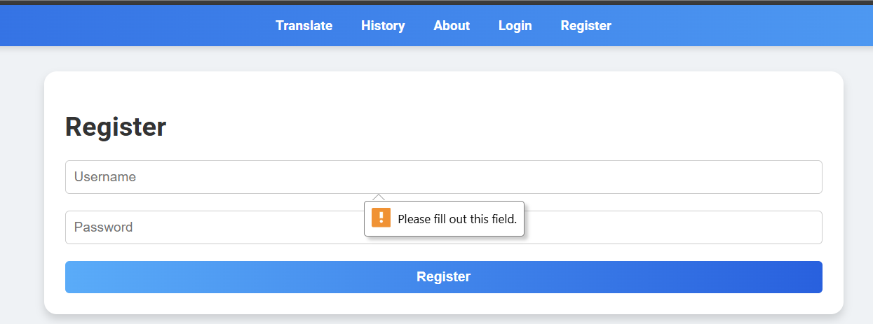
Sample Outputs and checks

Slide 21
REFERENCES
litcharts, Shakescleare - Every Shakespeare play, poem, and sonnet alongside a modern English translation everyone can understand.
https://medium.com/@ageitgey/build-your-own-google-translate-quality-machine-translation-system-d7dc274bd476; Build Your Own ‘Google Translate’-Quality Machine Translation System
https://arxiv.org/pdf/2010.11934; mT5: A Massively Multilingual Pre-trained Text-to-Text Transformer
https://huggingface.co/docs/transformers/v4.17.0/en/tasks/translation, Translation
Roudranil/finetuning-llms-for-conversation-in-shakespearean-english (github.com)
Roudranil/shakespearean-and-modern-english-conversational-dataset · Datasets at Hugging Face
Notes:
References:
These are the some of the references of the topics that mostly included in this paper.

Slide 22
Thank You

